Slide 1
CTM 1A
Sections 14.3 Adding and Subtracting Rational Expressions

Slide 2
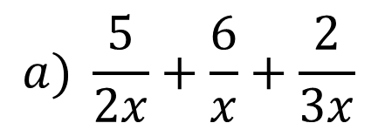
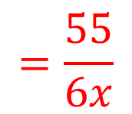
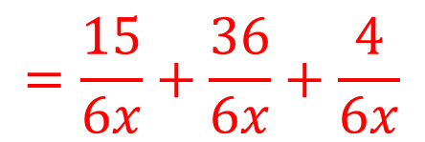
Rational Expressions
Add or subtract. Reduce to simplest form. (Examples)
$$a) \frac{5}{2x}+\frac{6}{x}+\frac{2}{3x}$$
$$LCD=2∙3∙x=6x$$
$$\frac{5}{2x}∙\frac{3}{3}+\frac{6}{x}∙\frac{6}{6}+\frac{2}{3x}∙\frac{2}{2}$$
$$=\frac{15}{6x}+\frac{36}{6x}+\frac{4}{6x}$$
$$=\frac{55}{6x}$$

Slide 3
Rational Expressions
Add or subtract. Reduce to simplest form. (Examples)
$$b) \frac{5}{x+1}+\frac{4}{x−1}$$
$$LCD=(x+1)(x−1)$$
$$\frac{5}{x+1}∙\frac{x−1}{x−1}+\frac{4}{x−1}∙\frac{x+1}{x+1}$$
$$=\frac{5(x−1)}{(x+1)(x−1)}+\frac{4(x+1)}{(x−1)(x+1)}$$
$$=\frac{5x−5}{(x+1)(x−1)}+\frac{4x+4}{(x−1)(x+1)}$$

Slide 4
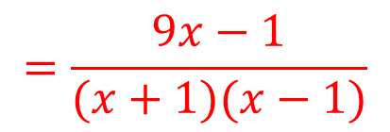
Rational Expressions
Add or subtract. Reduce to simplest form. (Examples)
$$b) \frac{5}{x+1}+\frac{4}{x−1}$$
$$LCD=(x+1)(x−1)$$
$$\frac{5}{x+1}∙\frac{x−1}{x−1}+\frac{4}{x−1}∙\frac{x+1}{x+1}$$
$$=\frac{5x−5}{(x+1)(x−1)}+\frac{4x+4}{(x−1)(x+1)}$$
$$=\frac{9x−1}{(x+1)(x−1)}$$

Slide 5
Rational Expressions
Add or subtract. Reduce to simplest form. (Examples)
$$c) \frac{2}{x−3}−\frac{4x}{x^{2}−9}$$
$$LCD=(x−3)(x+3)$$
$$\frac{2}{x−3}−\frac{4x}{(x−3)(x+3)}$$

Slide 6
Rational Expressions
Add or subtract. Reduce to simplest form. (Examples)
$$c) \frac{2}{x−3}−\frac{4x}{x^{2}−9}$$
$$LCD=(x−3)(x+3)$$
$$\frac{2}{x−3}∙\frac{x+3}{x+3}−\frac{4x}{(x−3)(x+3)}$$
$$=\frac{2(x+3)}{(x−3)(x+3)}−\frac{4x}{(x−3)(x+3)}$$
$$=\frac{2x+6}{(x−3)(x+3)}−\frac{4x}{(x−3)(x+3)}$$

Slide 7
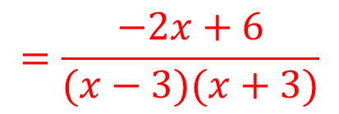
Rational Expressions
Add or subtract. Reduce to simplest form. (Examples)
$$c) \frac{2}{x−3}−\frac{4x}{x^{2}−9}$$
$$LCD=(x−3)(x+3)$$
$$\frac{2}{x−3}∙\frac{x+3}{x+3}−\frac{4x}{(x−3)(x+3)}$$
$$=\frac{2x+6}{(x−3)(x+3)}−\frac{4x}{(x−3)(x+3)}$$
$$=\frac{−2x+6}{(x−3)(x+3)}$$

Slide 8
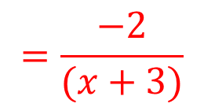
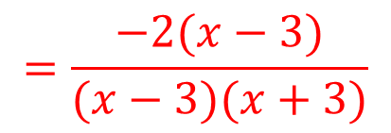
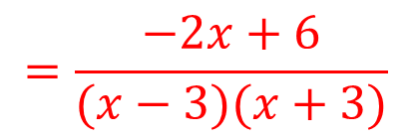
Rational Expressions
Add or subtract. Reduce to simplest form. (Examples)
$$c) \frac{2}{x−3}−\frac{4x}{x^{2}−9}$$
$$LCD=(x−3)(x+3)$$
$$\frac{2}{x−3}∙\frac{x+3}{x+3}−\frac{4x}{(x−3)(x+3)}$$
$$=\frac{−2x+6}{(x−3)(x+3)}$$
$$=\frac{−2(x−3)}{(x−3)(x+3)}$$
$$=\frac{−2}{(x+3)}$$

Slide 9
Rational Expressions
Add or subtract. Reduce to simplest form. (Skill Check)
$$a) \frac{4}{x+3}+\frac{2}{x+3}+\frac{2x}{x+3 } 2$$
$$b) \frac{6}{x+3}+\frac{4}{x−1} \frac{2\left(5x+3\right)}{\left(x+3\right)\left(x−1\right)}$$

Slide 10
Rational Expressions
Add or subtract. Reduce to simplest form. (Skill Check)
$$c) \frac{5}{2x+1}−\frac{2}{x−1} \frac{3\left(3x−1\right)}{\left(2x+1\right)\left(x−1\right)}$$
$$d) \frac{6}{x^{2}+4x+3}−\frac{4}{x+1} \frac{−2\left(2x−3\right)}{\left(x+3\right)\left(x+1\right)}$$

Slide 11
Rational Expressions
Add or subtract. Reduce to simplest form. (Skill Check)
$$e) \frac{\frac{7}{x+2}−\frac{5}{3−x}}{ \frac{3}{2−x}−\frac{2}{x−2}} \frac{−2\left(x−2\right)}{x+2}$$

